Slide 1
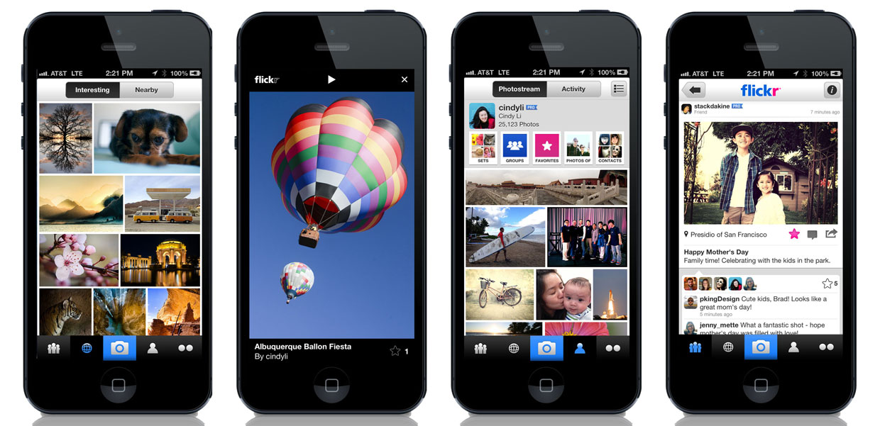
Photo App/Web editor Research

Slide 2
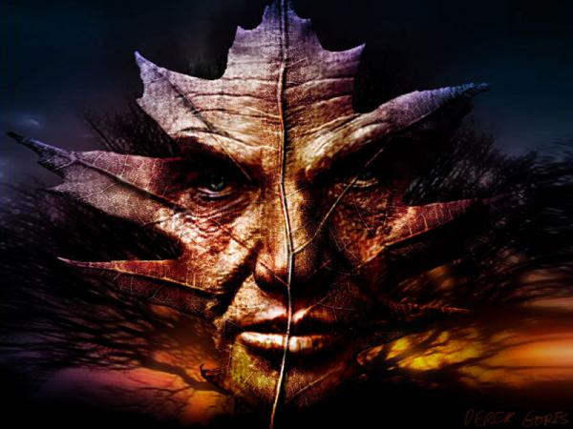
Find a Photo App or a website photo editing site that you would like to use for manipulating photos. The goal is that editor you choose will be used to make digital works of art from some of your photos.

Slide 3
Now it’s time for you to do some research on your chosen photo app/website editor.
APP:
There are tutorials all over the internet on these apps. Find a variety of these tutorials and begin experimenting with your app and all of its functions.
While you are researching your app make sure to document the needed information to have for your assignment (that information is on the next slide).
WESITE:
Play around with the website and figure out its abilities. Research further information through tutorials.

Slide 4
Title your Assignment with the name of the App/website on your page
Add the following under your title:
Links to tutorials for this app/web editor (there is a link option on weebly)
Examples of digital art created using this app/editor (by other artists found while researching) *Be sure to label the work that you found...or it will appear to be yours*
If it is an App:
Devices that are able to install the app (ex. Iphone, android, etc.)
Cost of the app (we prefer the free apps)

Slide 5
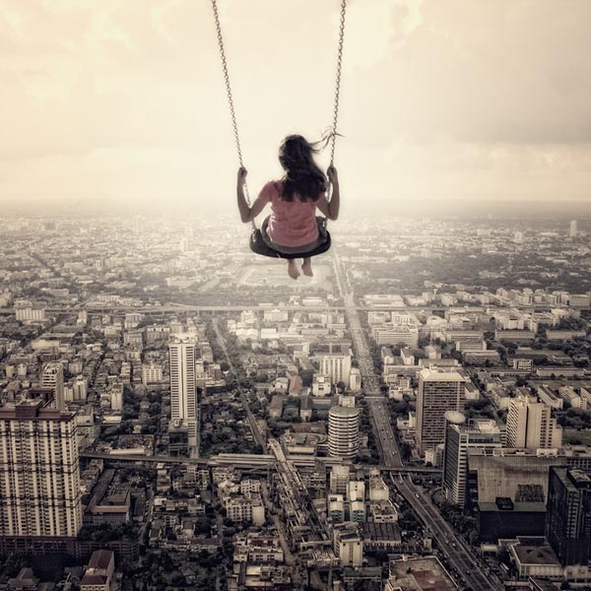
Next you are to create at least three examples of digital art from photos that you have taken using your chosen Photo App/editing site. Post each edited photo with the original photos onto your page with the information.

Slide 6
How will you be graded?
You must have all required criteria in your Page!
Completed on time
3 examples of digital art with originals
Effort to create interesting edited photo art
Effort put forth during class time

